Slide 1

FINAL DIY PROJECT SEMeSTER-1 GROUP- 8

Slide 2
TITLE Automatic Temperature controlled fan and Humidity controller

Slide 3
OBJECTIVES OF OUR PROJECT
TO CONTROL THE SPEED OF THE FAN ACCORDING TO THE TEMPERATURE CHANGES. THIS NOT ONLY LEADS TO AUTOMATION BUT ALSO SAVES A BIT OF ELECTRICAL ENERGY.
TO CONTROL THE HUMIDITY LEVEL OF THE SURROUNDINGS BY USING A HUMIDITY CONTROLLER. THE HUMIDIFIER WILL AUTOMATICALLY GET STARTED IF THE SURROUNDING HUMIDITY FALLS BELOW A THRESHOLD LEVEL.
THIS WILL SOLVE THE SKIN PROBLEMS OCCURRED DUE TO THE LOW HUMIDITY (SKIN DRYNESS etc.) AND THIS ALSO SAVES ELECTRICAL ENERGY.

Slide 4
GROUP MEMBERS
SATYAJIT BEHERA – ( 21AG10034)
SUBHAJIT BHAUMIK-(21ME10081)
KETHAVATH SHIV KUMAR-(21MI31013)
HARISH TAKRI-(21CY10016)
TEJAARKA P-(21MT10036)
VANKUDOTH PAVAN-(21CH10075)

Slide 5
WORK DISTRIBUTION
PHYSICAL ASSEMBLY- SATYAJIT BEHERA
CODING – SUBHAJIT BHAUMIK AND TEJAARKA
VIRTUAL CIRCUIT MAKING – PAVAN
VIDEO EXPLANATION- 1) SATYAJIT 4)HARISH 2) SUBHAJIT 5) TEJAARKA 3)PAVAN 6)SHIVA
VIDEO EDITING – HARISH AND SHIVA

Slide 6
COMPONENTS
1.ARDUINO UNO 7.DHT-22
2.BREADBOARD 8.RESISTOR
3.JUMPER WIRE 9.BATTERY
4. HUMIDIFIER(MIST PRODUCER) 10.LCD
5.FAN 11.RELAY
6.LM 35 12.MOSEFET(TRANSISTOR)
TOTAL BUDGET- RS.3150

Slide 7
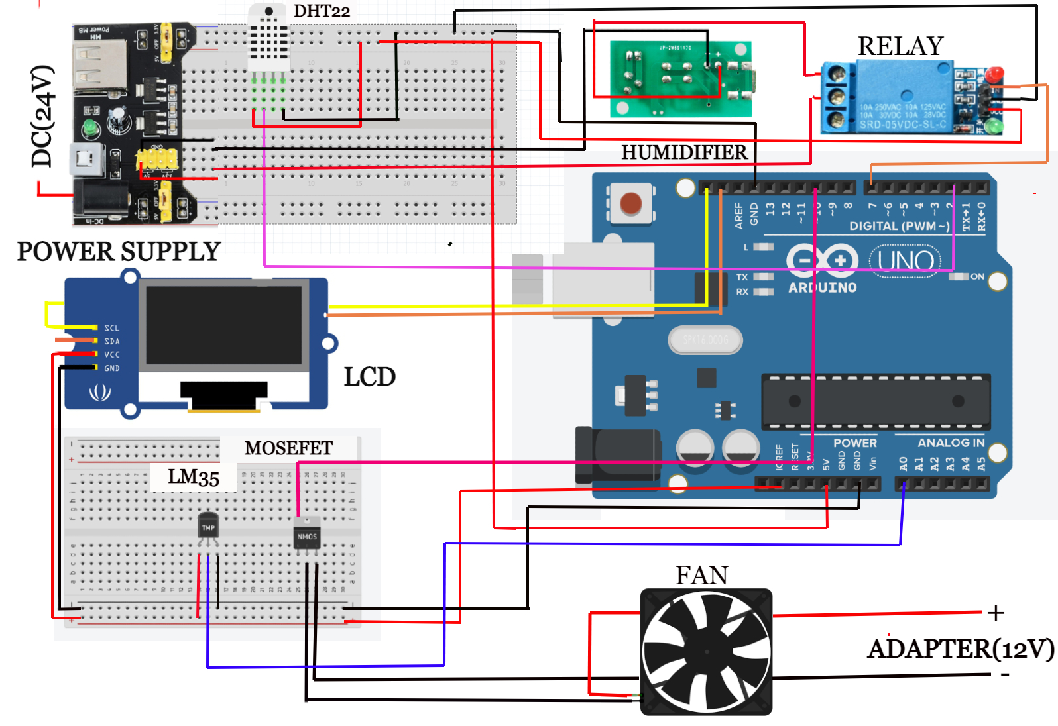
CIRCUIT

Slide 8
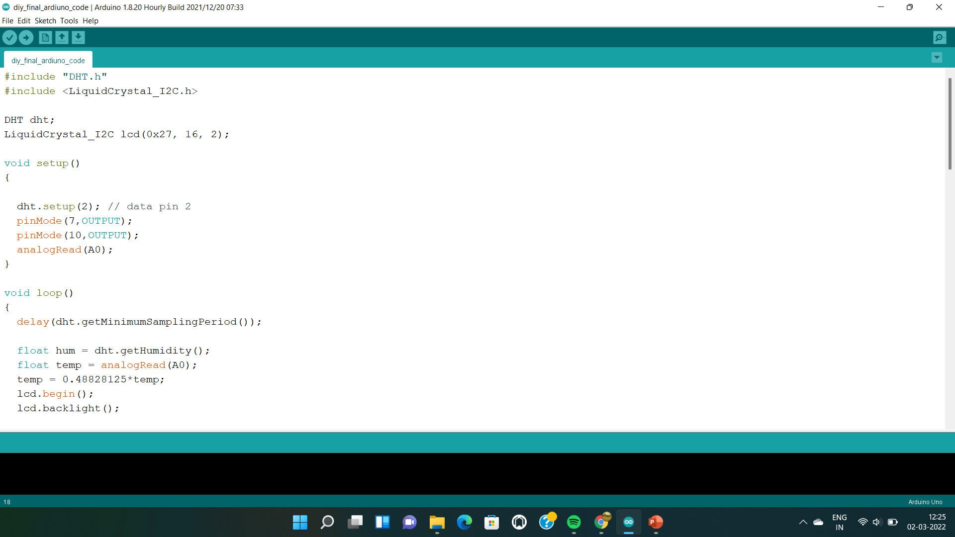
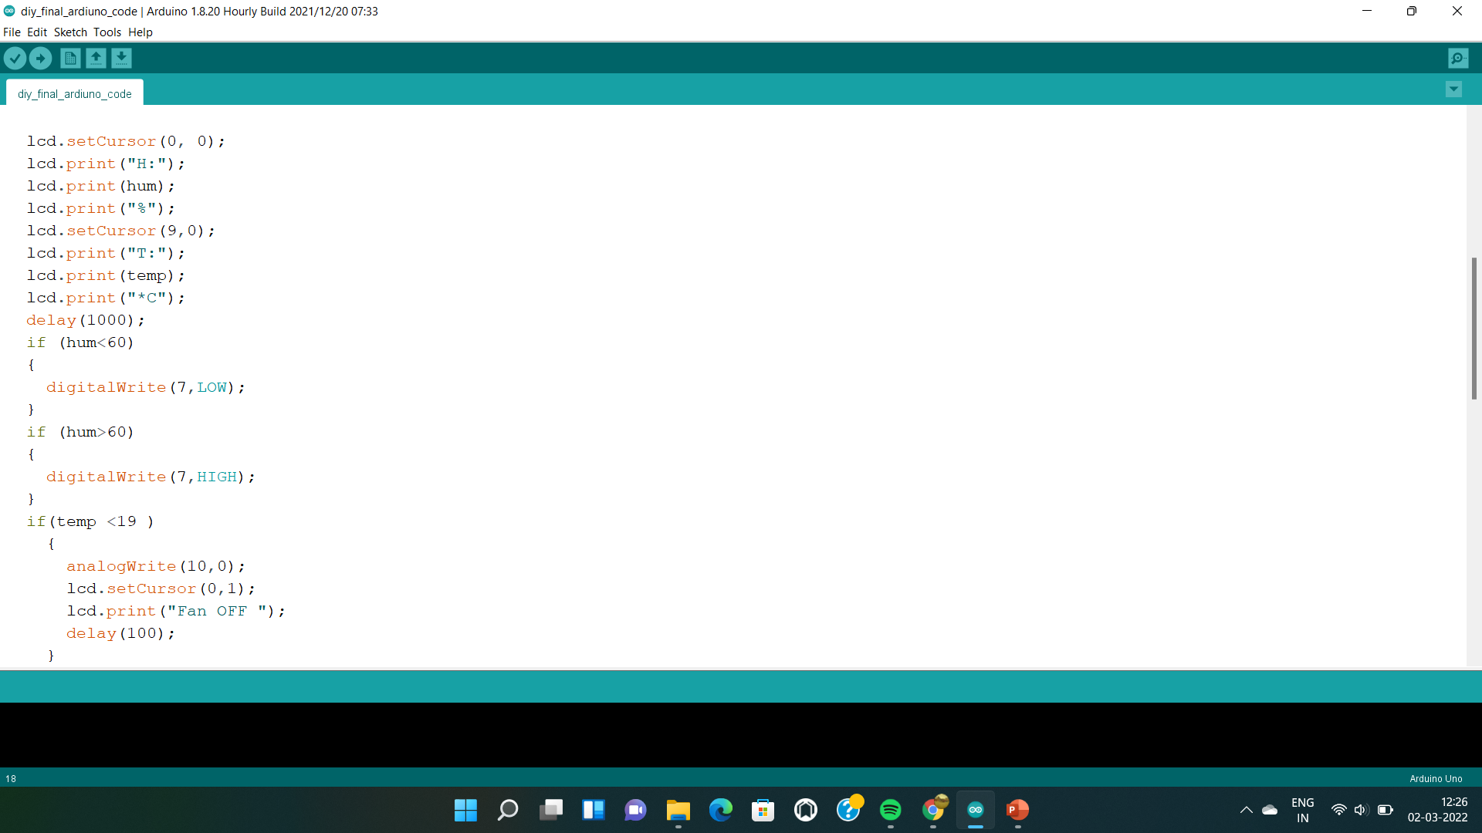
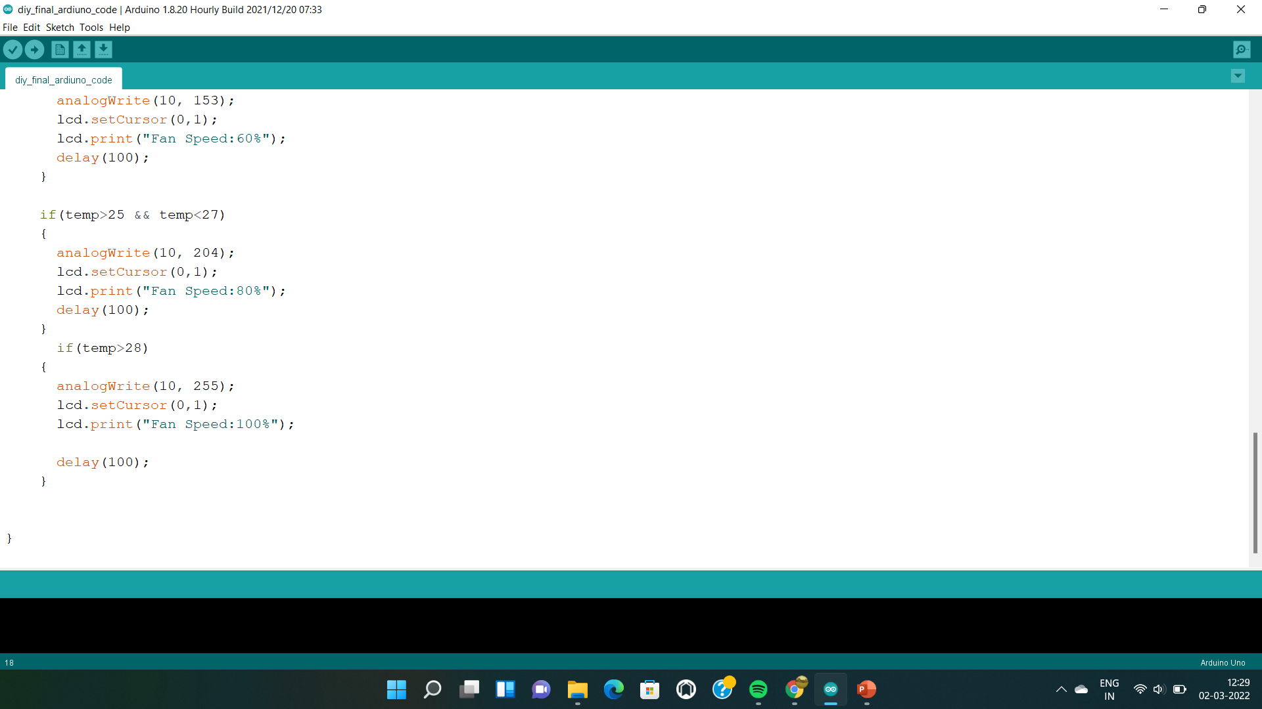
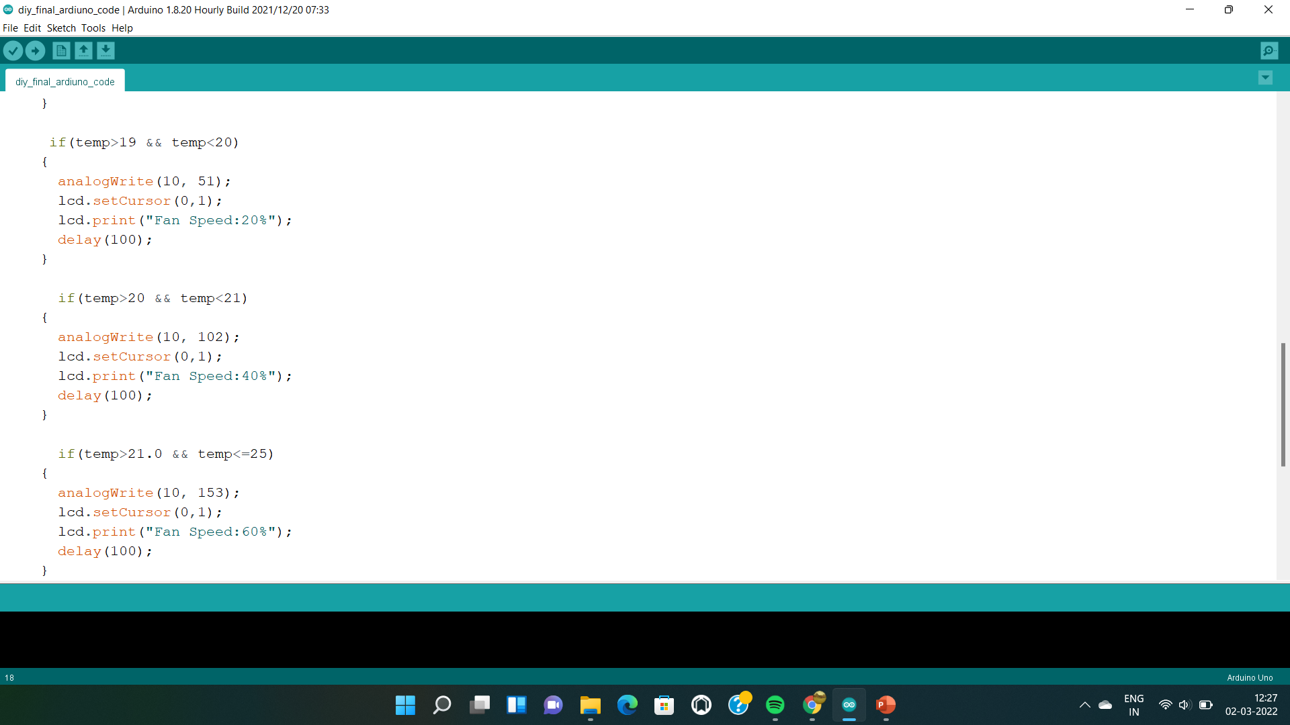
CODING

Slide 9
OUR DEMONSTRATION VIDEO LINK
https://youtu.be/NB_XEwP2avo

Slide 10
THANK YOU

